Slide 1

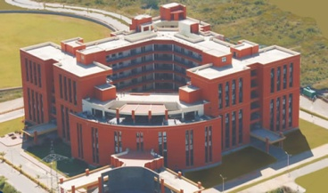
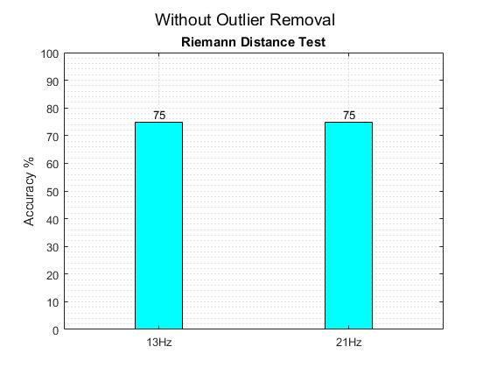
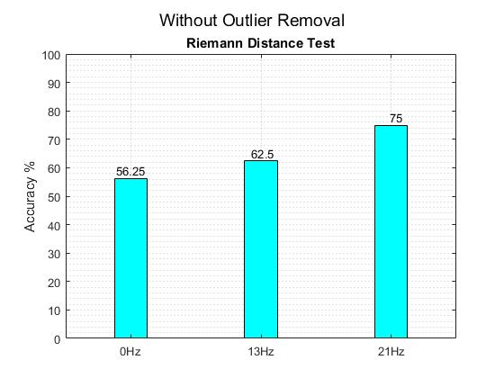
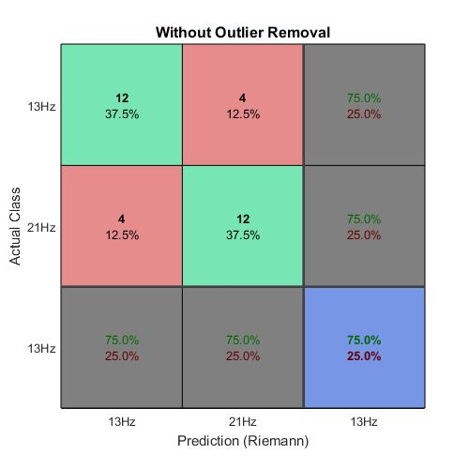
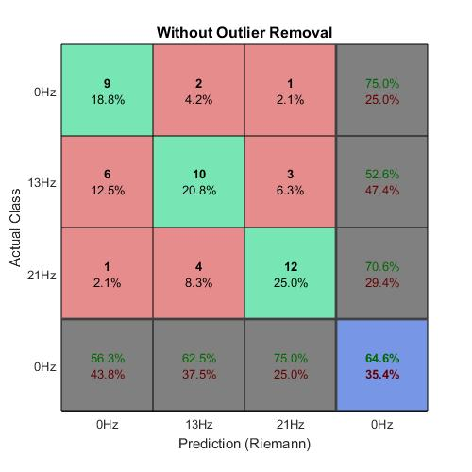
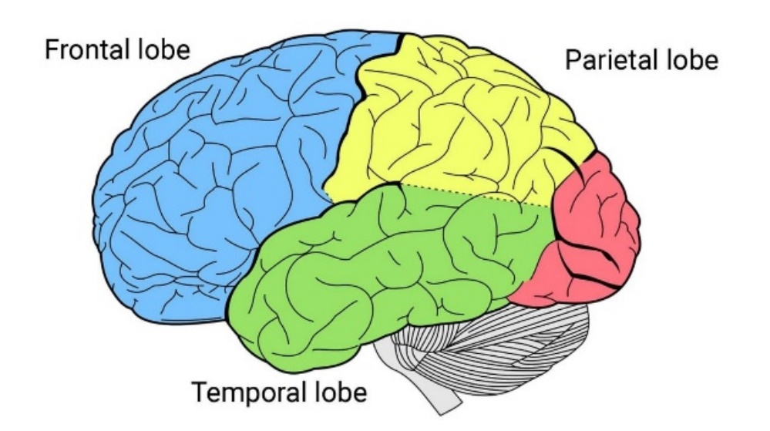
Department of Electronics and Communication Engineering
PESIT – Bangalore South Campus
Brain Computer Interfacing:- SSVEP Classification
Description
Results
Brain Computer interfacing is a system that establishes a communication pathway between the brain and an external computing device. We are looking at SSVEP, out of the many possible BCI paradigms. This phenomenon is the response of the brain to a flickering source of light. The response has been observed to have a waveform embedded in it, which is frequency and phase locked to this flickering stimulus.
Our project implements an SSVEP classifier using a statistical analysis of the EEG waveform. We are using a recently emerged EEG processing technique that relies on covariance matrices and their inherent geometry in a riemannian space to cluster and classify EEG signals.
The stimulus for generating the EEG readings come from an astable multivibrator circuit that controls an array of flickering LEDs. The project is implemented on MATLAB.
General Idea
Features
EEG Digital Database
Digital Filter
Data Matrix
Classifier Algorithm
Class Prediction
Application
Classification is done using covariance of EEG data to cluster and classify as needed.
This algorithm can also detect No-SSVEP state/ Resting state along with any predefined SSVEP frequency.
Outlier removal can be done to make it robust against noise.
Training is relatively quicker than conventional SSVEP classification algorithms.
Fig. 1: General Setup
Application
Team Members
The classifier can be used in a real-time scenario to control wheelchairs. Four LEDs flickering at different frequencies can be assigned for forward, backward, left and right directions.
A robotic arm can be controlled to write messages, again by assigning set frequencies to an array of flickering LEDs
Any application where simple remote controlling is required.
Guide: Prof. Vidya T.V
Lakshmiraj C.R. 1PE14EC412
Pavan Kumar D. 1PE14EC094
Prashanth H.C 1PE14EC099
Sawan S.M 1PE14EC128

